Slide 1


REPORT DATABASE MANAGEMENT – MARKET DATA FORECAST

Slide 2
CONTENTS
01
ABOUT CLIENT
02
NORMALIZATION ANALYSIS
03
ERD DIAGRAMS
04
ER SCHEMA
05
SQL QUERIES
06
RECOMMENDATIONS
Notes:
© Copyright Showeet.com

Slide 3






01
OUR TEAM
Company Overview
HARISH DATTA
CHITNENI
VENKATA SAI TEJA GANGUMALLA
GOUTHAM KUMAR VEMASANI
PRATHYUSHA REDDY MIDUDHULA
SANJAY
KATYAL
MAXWELL
MCTIGUE
1

Slide 4
01
1
ABOUT CLIENT
Company Overview
Business Overview
Market Data Forecast is a provider of syndicated and custom-made market research, business intelligence and consulting services
They are associated with many fortune listed companies and publish wide range of reports with deep insights covering specifics in detail for all industry verticals.
Key Facts
Company Title | Market Data Forecast
Company Type | Private Limited
Industry | Market Research
Founding Year | June 2016
2

Slide 5
02
1
ABOUT CLIENT – BUSINESS ECOSYSTEM
Our Research Domains
BUSINESS ECOSYSTEM
Employees
Content Writers:
Employees of the company who work on writing articles/report descriptions
Reports:
List of all reports written by content writers and uploaded onto website by marketing team
Leads:
List of clients that have enquired about a particular report on our website.
Upload content on website
Generate leads
QC Analysts:
Employees of the company who work on quality checks the content and provide an approval
Domain:
List of industry domains to which a particular published report belongs.
Region:
Origin of client location. List of all countries along with respective continent/region
Marketing Analysts:
Employees of the company who work on marketing the written content and generate leads
3

Slide 6
02
1
ABOUT CLIENT – BUSINESS ECOSYSTEM
Our Research Domains
List of reports that are published on website.
Content writer writes the Report Description (introduction to our services particular to that industry topic)
QC Analyst perform a quality check on content
Marketing Team publishes it on website
A lead is generated upon client interest for a particular report
4

Slide 7
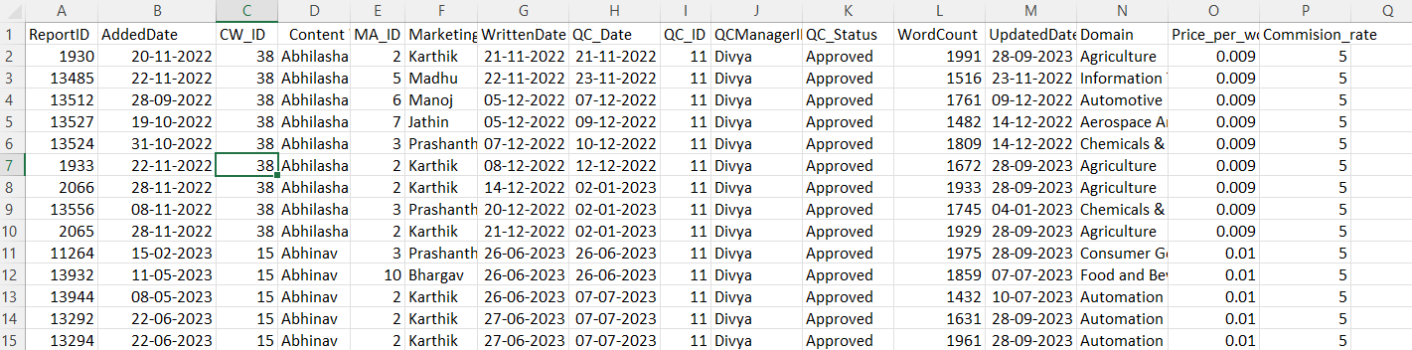
2
NORMALIZATION ANALYSIS
Client’s data:
TABLE 1 = ‘reports.csv’
TABLE 2 = ‘leads.csv’
TABLE 3 = ‘employees.csv’
TABLE 1: reports (2 NF)
Transitive dependencies in reports_Table:
ReportID → DomainID → Domain.
ReportID → ContentWriterID → ContentWriter.
ReportID → QCManagerID → QCManager.
ReportID → ContentWriterID → price_per_word.
ReportID → DomainID → MarketingAnalyst
5

Slide 8
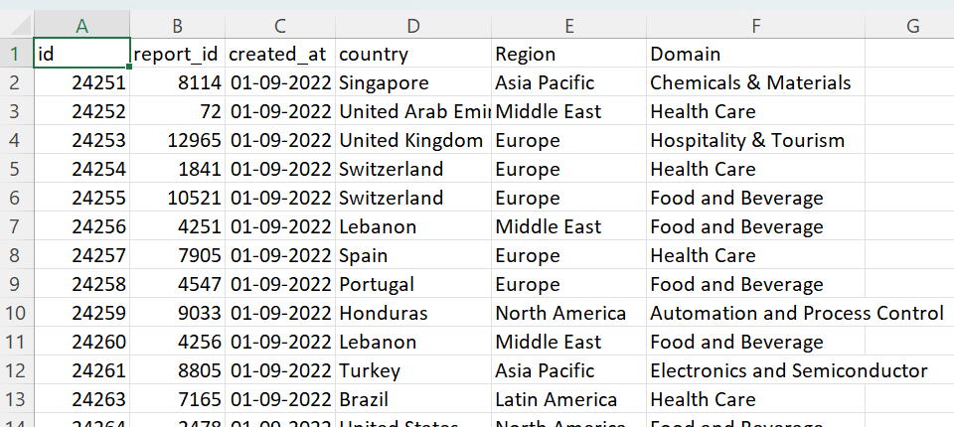
2
NORMALIZATION ANALYSIS
Client’s date:
TABLE 1 = ‘reports.csv’
TABLE 2 = ‘leads.csv’
TABLE 3 = ‘employees.csv’
TABLE 2: leads (2 NF)
Transitive dependencies in leads_Table:
Id → country → continent
Id → ReportID → Domain
6

Slide 9
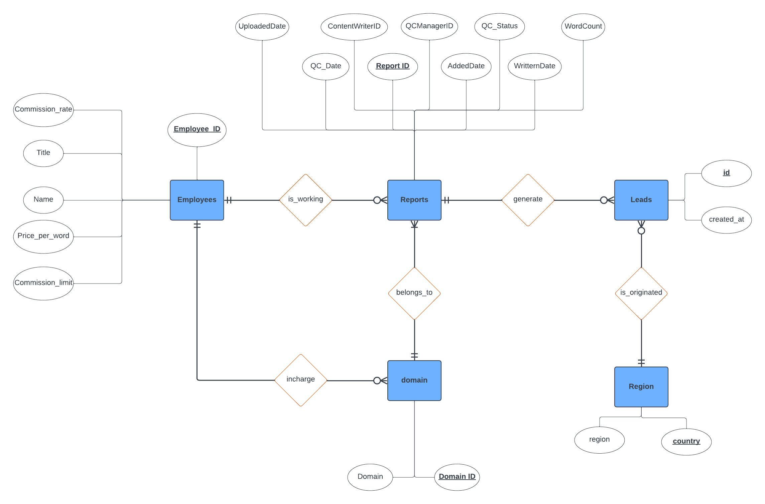
3
ERD DIAGRAM
7

Slide 10
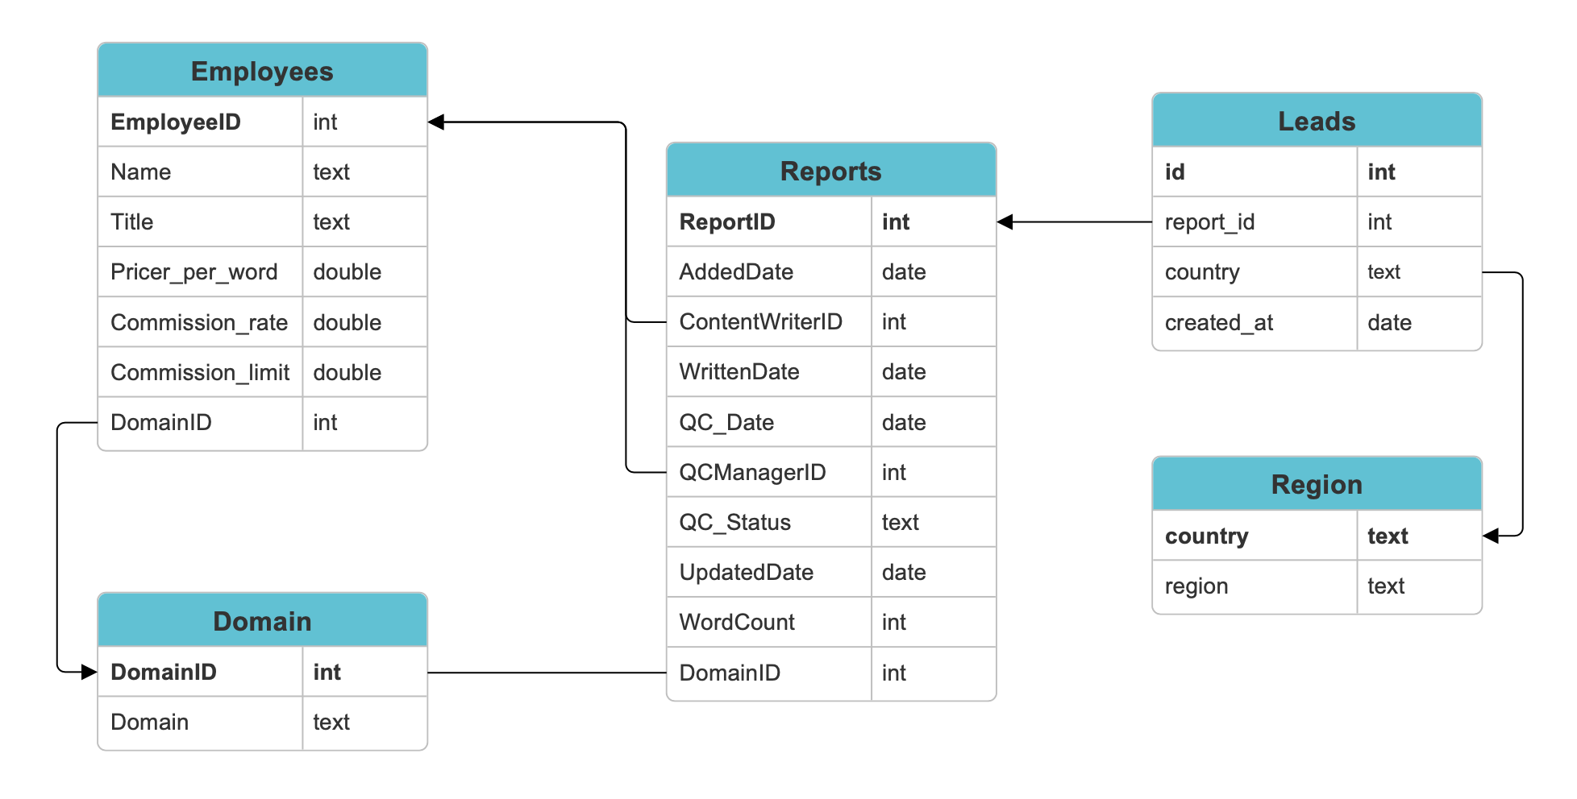
4
ER SCHEMA
8

Slide 11

5
QUERY 1 – Amount to be paid to Content Writers
Company pays their content writers based on the content they write
Salary varies for writers each month
Company wants to understands how much to pay to each content writer each month
9

Slide 12
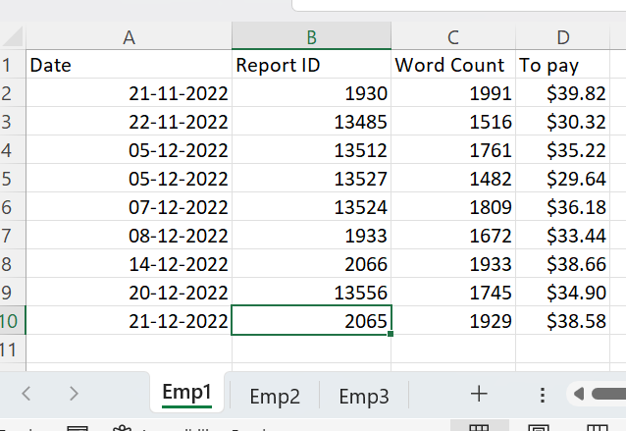
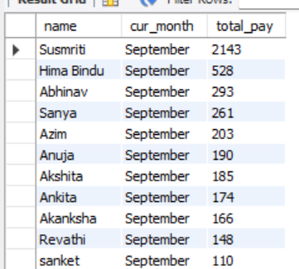
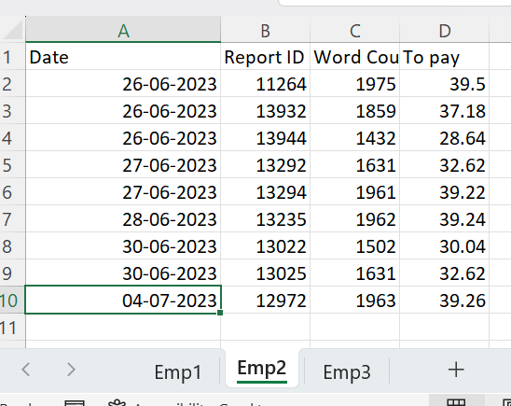
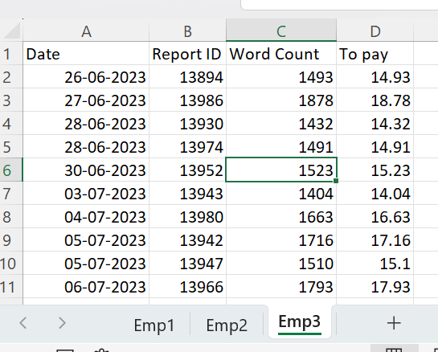
5
QUERY 1 – Amount to be paid to Content Writers
Current process
Using SQL
10

Slide 13

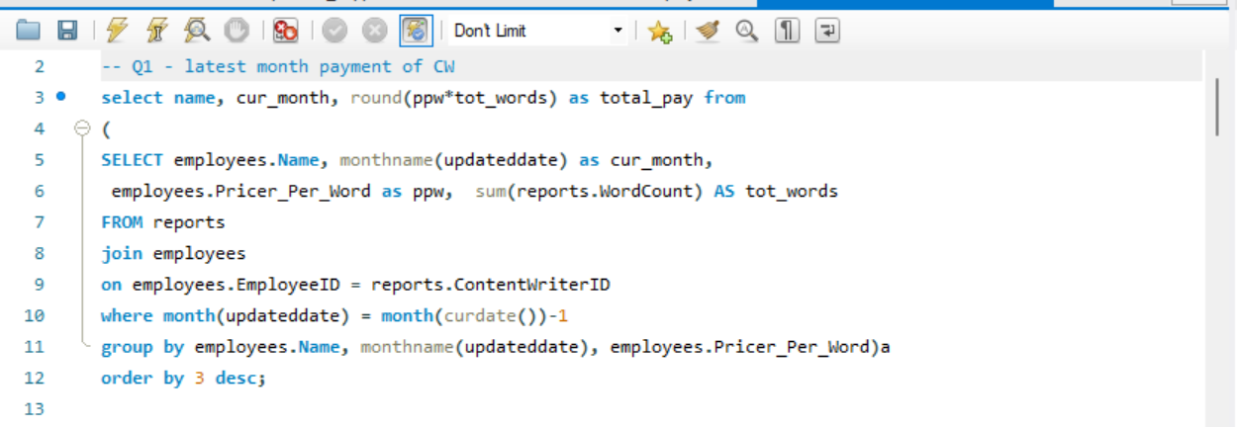

5
QUERY 1 – SQL CODE
11

Slide 14
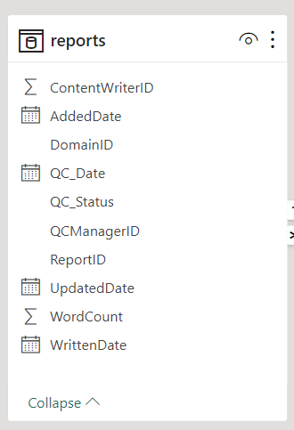
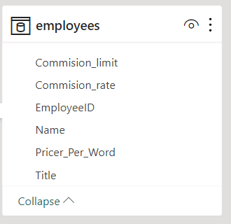
5
QUERY 2 – Monthly Expenditure on Content Creation
Objective to understand how company’s spend on content varies monthly
Expenditure = Sum(wordcount * Price_per_word)
12

Slide 15
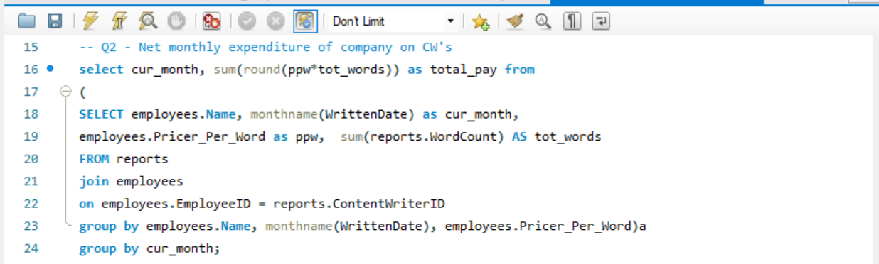
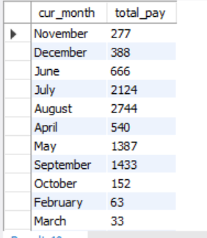
5
QUERY 2 – SQL CODE
13

Slide 16
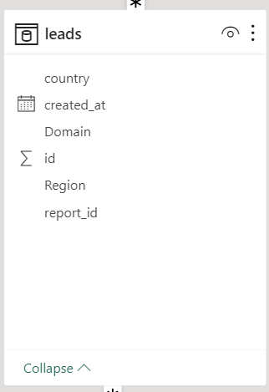
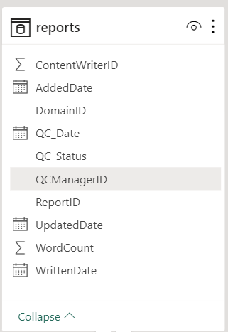
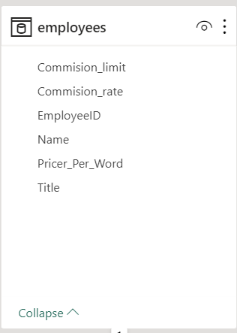
5
QUERY 3 – Commission Rate
Content writers earns commission if the content written by a writer gets hits in the website
There is also a limit (threshold) of how much a writer can earn in a year ($100)
14

Slide 17
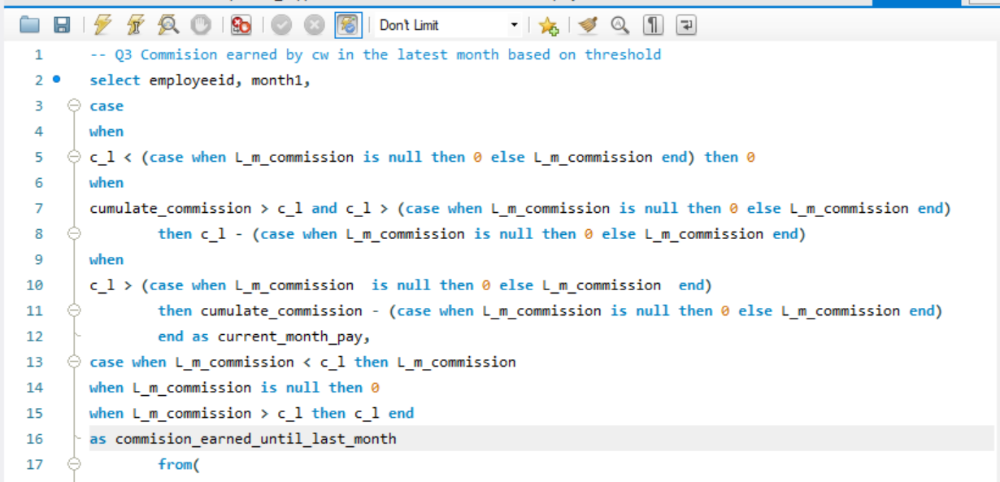
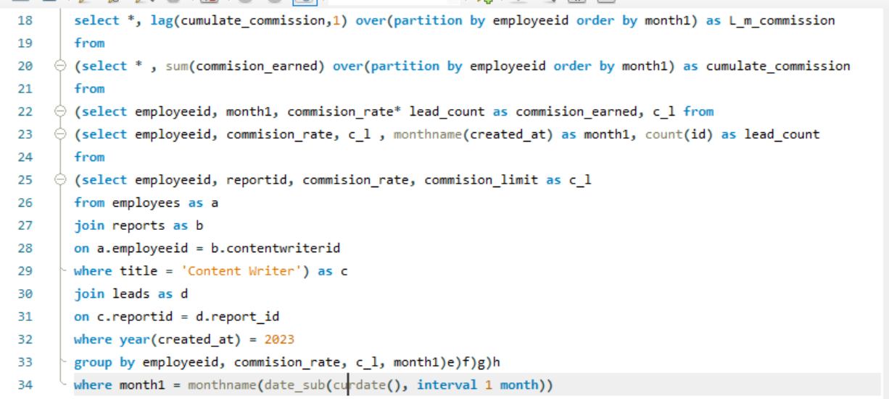
5
QUERY 3 – SQL CODE
15

Slide 18
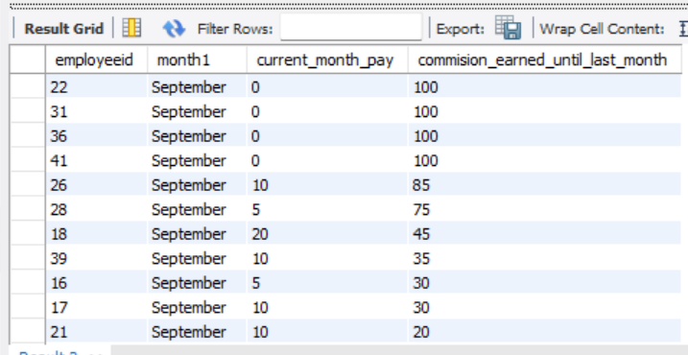
5
QUERY 3 – SQL CODE
16

Slide 19
5
QUERY 4 – Publishing Efficiency
Write
Quality check
Publish
The company want to decrease the time between writing the article and publishing the articles onto the website
17

Slide 20
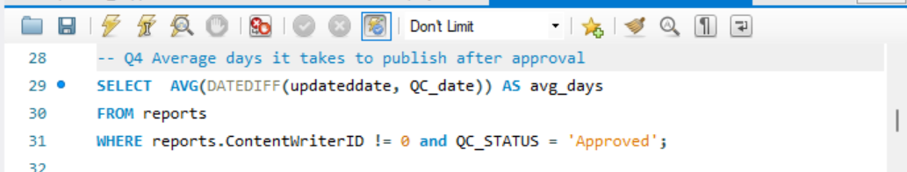
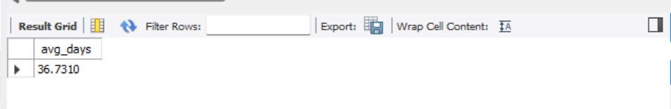
5
QUERY 4 – SQL CODE
18

Slide 21

5
QUERY 5 – Marketing Analyst Performance
Arranging the Marketing analysts by the lead count their report has produced
Helps in identifying top marketing performer
19

Slide 22
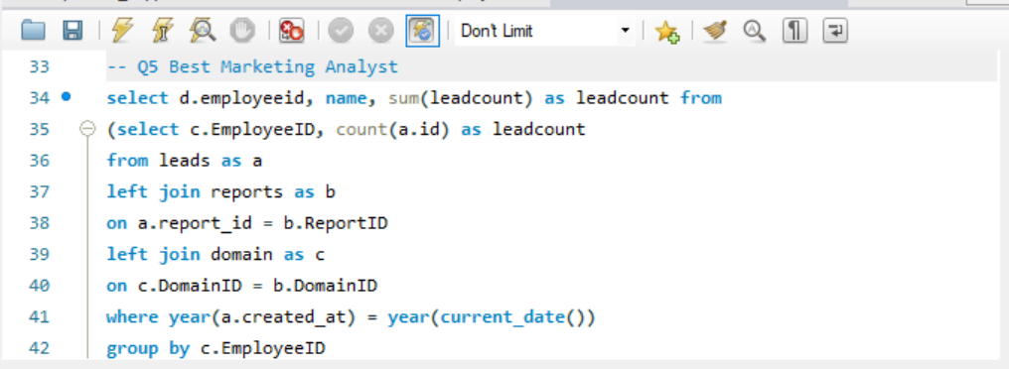
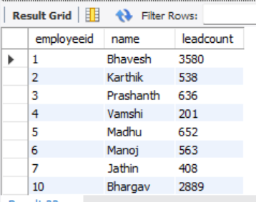
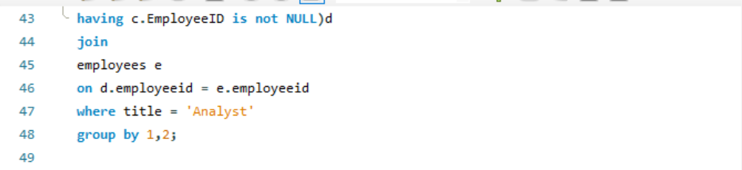
5
QUERY 5 – SQL CODE
20

Slide 23

5
QUERY 6 – Domains that are getting more hits
Company want to understand which domain specific reports/articles are getting more hits within 3 months of its publishing date
21

Slide 24
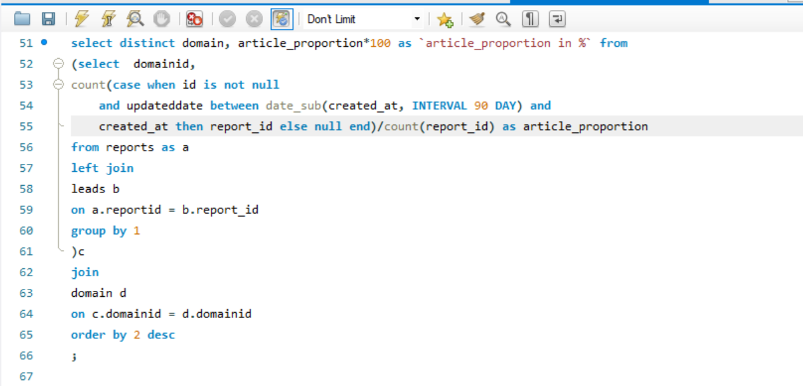
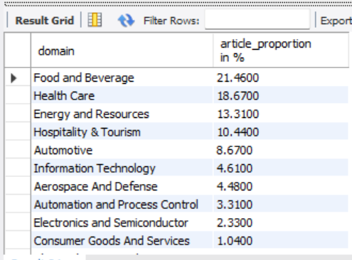
5
QUERY 7 – SQL CODE
22

Slide 25

5
QUERY 7 – Performance Index of Writer
It’s important for the company to gauge which employee’s content is producing better traffic to the website and who are not
To evaluate this, they would like to keep track of all content writers with zero leads in last 90 days
23

Slide 26
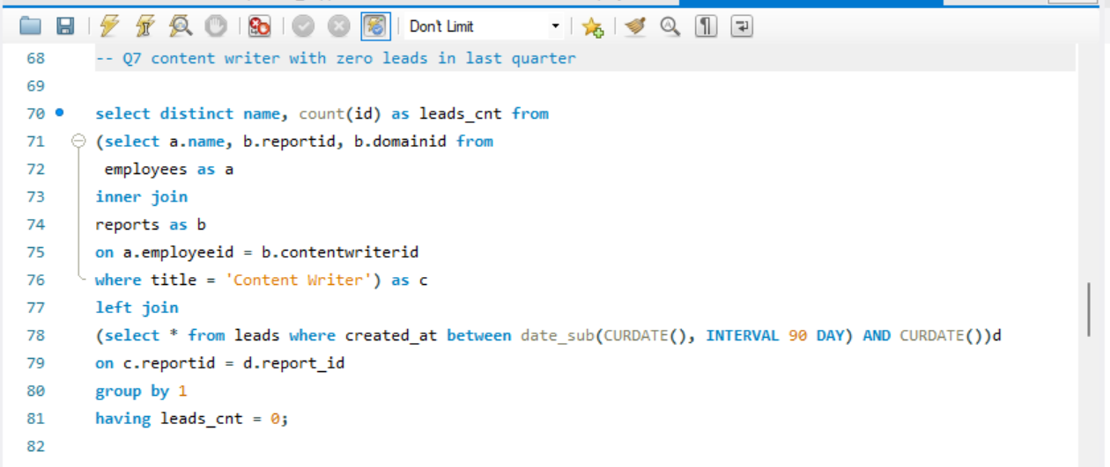
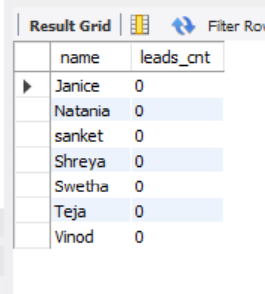
5
QUERY 8 – SQL CODE
24

Slide 27

5
QUERY 8 – Month-over-month change(%) in Marketing Analyst Performance
Marketing Analyst performance is mainly tracked by the number of leads they generate in a month
The company pays bonus to the employees based on their Month-on-month increase in the leads they generate
25

Slide 28
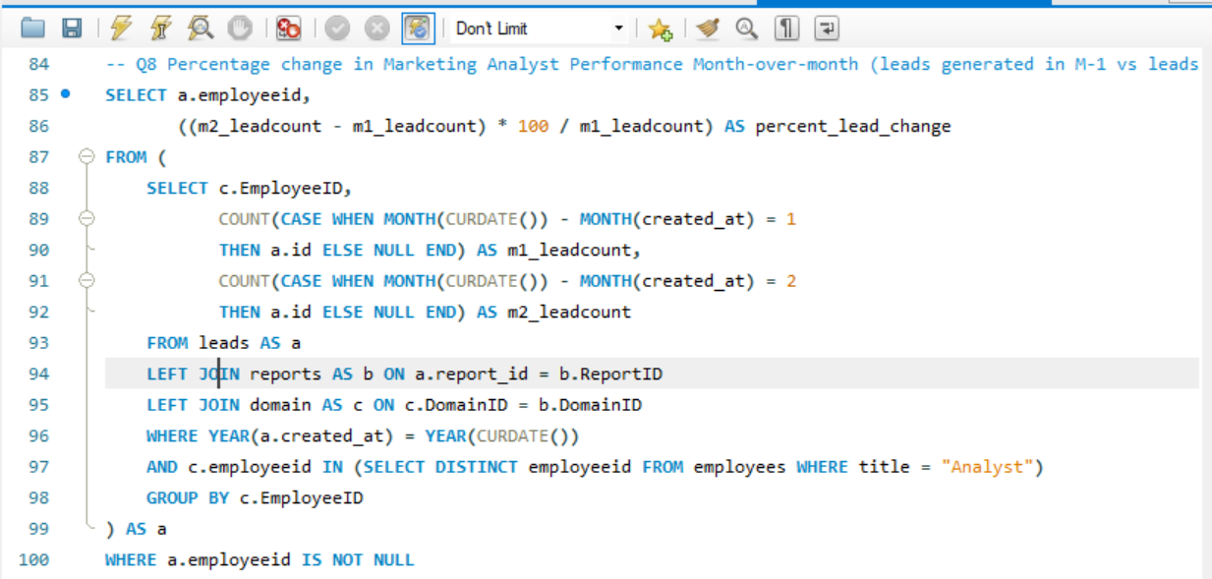
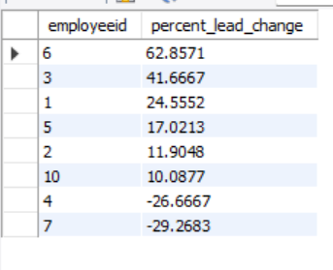
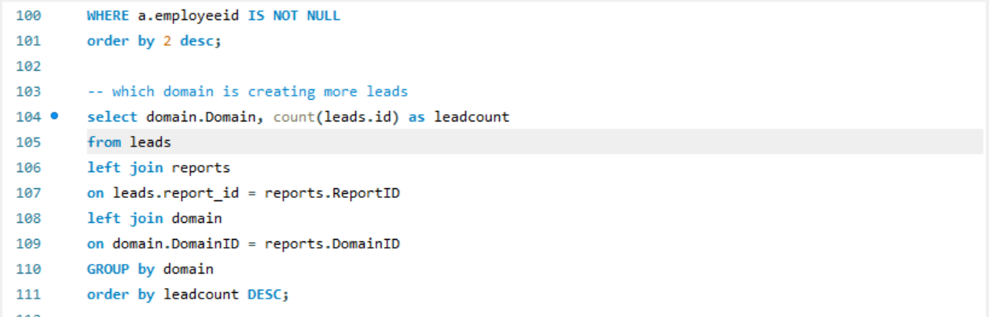
5
QUERY 8 – SQL CODE
26

Slide 29

5
QUERY 9 – Top lead generating Domain
It’s important for the company to gauge which employee’s content is producing better traffic to the website and who are not
To evaluate this, they would like to keep track of all content writers with zero leads in last 90 days
27

Slide 30
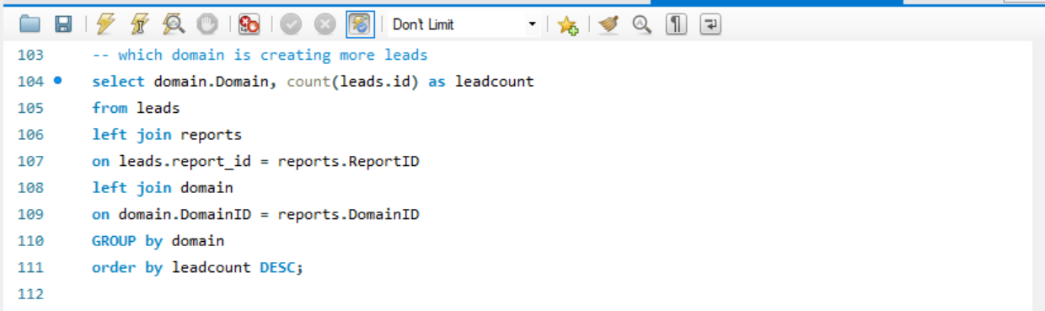
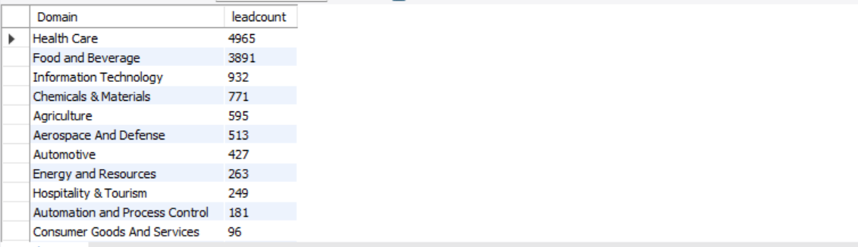
5
QUERY 9 – SQL CODE
28

Slide 31

5
QUERY 10 – Summary Statistics
To understand the month wise performance of each marketing member, identify the best performers and also the consistency level in performances.
29

Slide 32
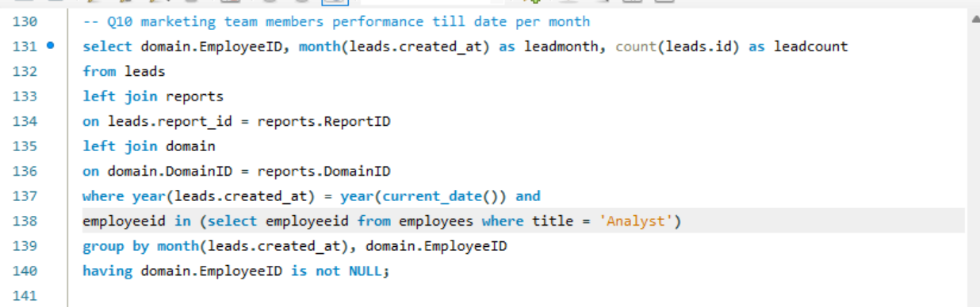
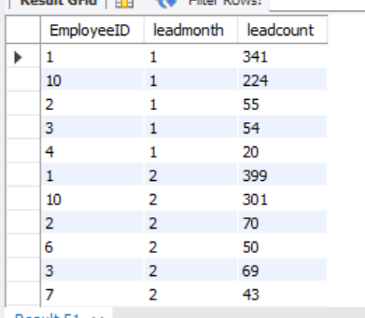
5
QUERY 10 – MONTHLY PERFORMANCE OF MARKETING TEAM MEMBERS
30

Slide 33

3
QUERY 11 – Top lead generating continent
Calculating :
To find the continent which generates most number of leads, we look at the aggregate leads generated, across the different continents
31

Slide 34
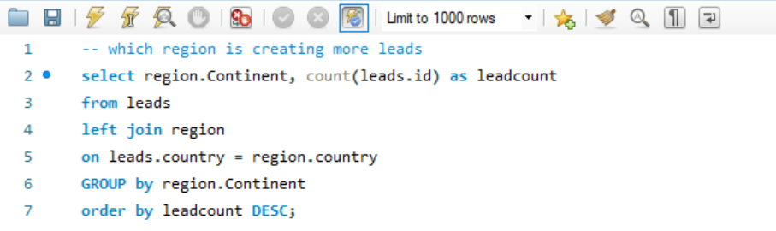
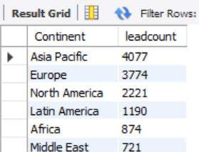
3
QUERY 11 – SQL CODE
32

Slide 35

3
QUERY 12 – Summary Statistics
Calculating :
The no of Leads in the last month
The no of reports written in the last month
The no of reports uploaded in the last month
33

Slide 36
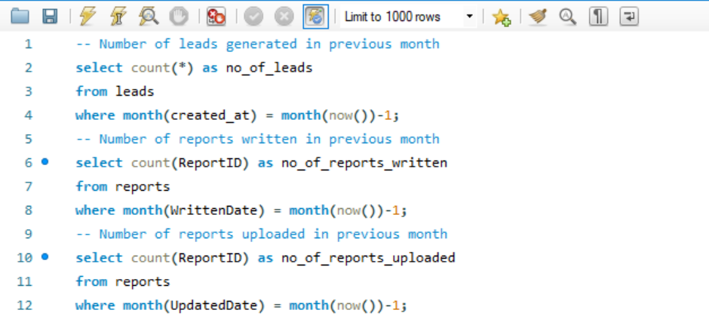
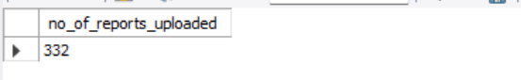
3
QUERY 12 – SQL CODE
34

Slide 37
3
RECOMMENDATIONS
Data Integrity and Validation:
Implement data validation checks to minimize manual data errors and ensure data accuracy.
Structured Storage:
Store all data in a structured format, adhering to the Third Normal Form (3NF), for easy reference in the future.
Scalability and Performance:
Design the database for computational efficiency, allowing it to handle large data volumes with minimal system lags.
Utilize appropriate indexing and partitioning strategies for performance optimization.
Data Volume:
Recognize that Excel is not suitable for storing extensive data sets due to limitations; an SQL database is better equipped for handling large amounts of data.
By following these recommendations, you can maintain data accuracy, structure, and performance, which Excel may struggle to handle for extensive data storage.
35

Slide 38
THANK YOU

